Slide 1

This presentation is
organised by
Heeralal Yadav Sir

Slide 2


DATE
October 25, 2025
SUBJECT
Business studies

Slide 3







Business Presentation
Business Environment
Understanding the Forces That Shape Organizations
Presented By:
Yogesh Bhansali
Kunal kumar
01

Slide 4




Business Environment
Concept of a business environment
Internal vs External Factors
The business environment shapes strategic decisions, influences growth opportunities, determines competitive positioning, and affects long-term sustainability.
Internal factors include company culture, management style, and resources.
Meanwhile
External factors encompass
economic conditions, competition,
and regulations.
02

Slide 5


Business presentation
Features
Of business environment
Have enternal and external
Forces
Inter-relatedness
Features
Totality of external forces
Dynamic in nature
General & specific forces
Uncertainty
Complexity
03

Slide 6





Internal Business Environment
Organizational Culture
Management Structure
Employee Capabilities
The shared values, beliefs, and practices that shape how employees interact and work together. A strong culture drives motivation, innovation, and organizational identity.
The hierarchy and framework that defines roles, responsibilities, and decision-making processes. Effective structure ensures clear communication and efficient operations.
The skills, knowledge, and expertise of the workforce that drive productivity and competitive advantage.
04

Slide 7







Importance of
Business
Environment
Opportunities and threat
It enables firm to identify the opportunity and threats.
Perfection
It makes the organisation perfect in order to get more and more advantages.
Planning and executing
It helps the organisation in planning and formation of their policy and in improving their performances.
05

Slide 8




Business Environment
Dimensions of
Business
Environment
Political factors include government policies, regulations, and political stability that directly impact business operations and strategic decisions.
Economic conditions like inflation, interest rates, and market trends shape consumer spending and business profitability.
Social, technological, legal, and environmental factors drive innovation, compliance needs, and sustainable practices.
06

Slide 9

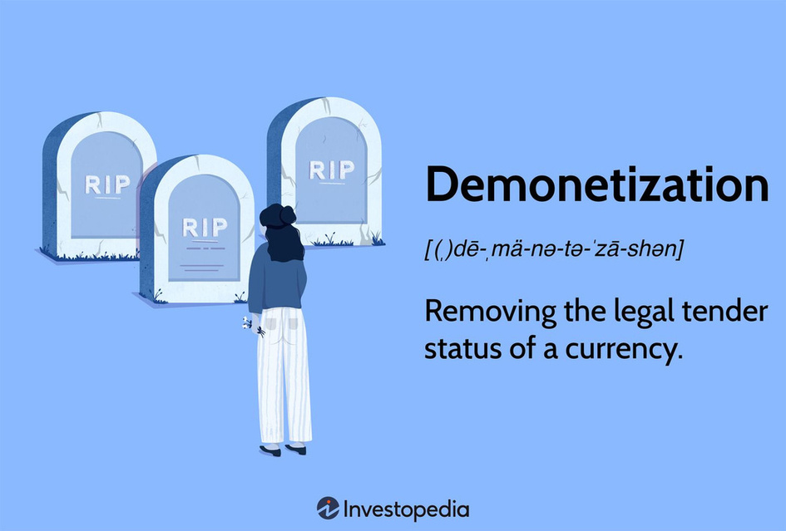
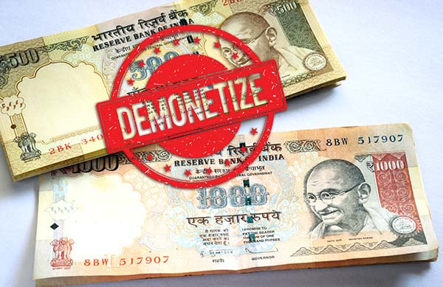
Business Environment
Business Presentation
What is
Demonetisation..?
It is the act of discontinuing a legal tender by the government pf that country.
It's glimpse was seen thrice in India
    First on 12th of January, 1946
    Second on 16th of January, 1978
    Third on 8th of November, 2016
07

Slide 10



Business Environment
Features of
Demonetisation
Elimination
Of
black money
Eradication
Of
corruption
Helps
to prevent
Money laundering
08

Slide 11


Business Environment
thank
you

